Slide 1

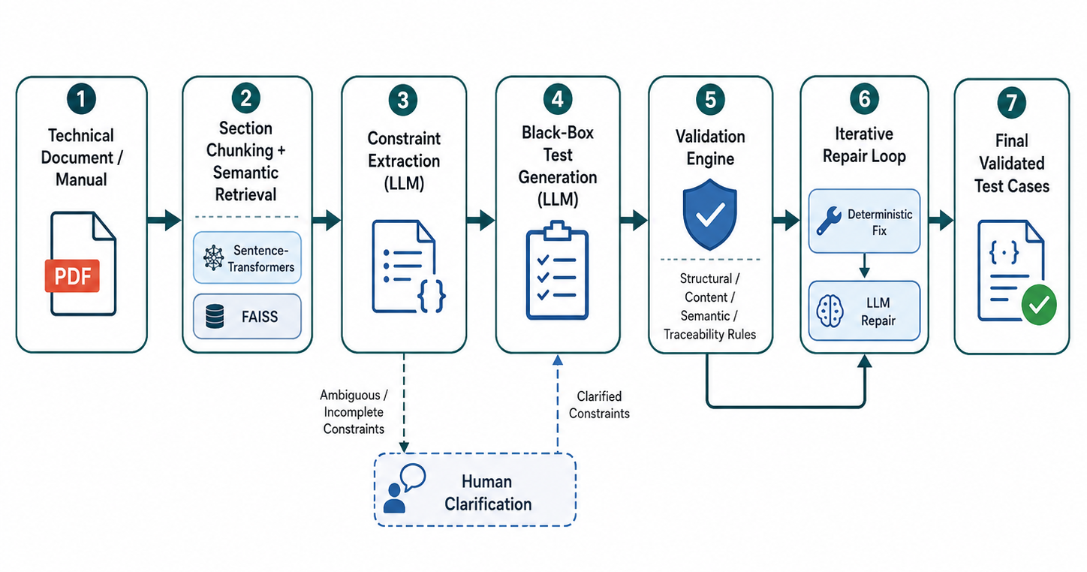
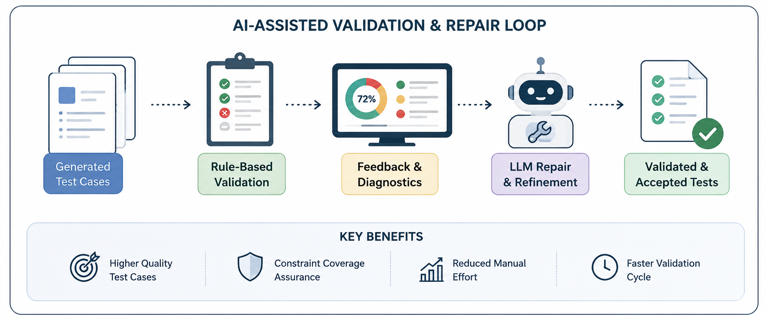
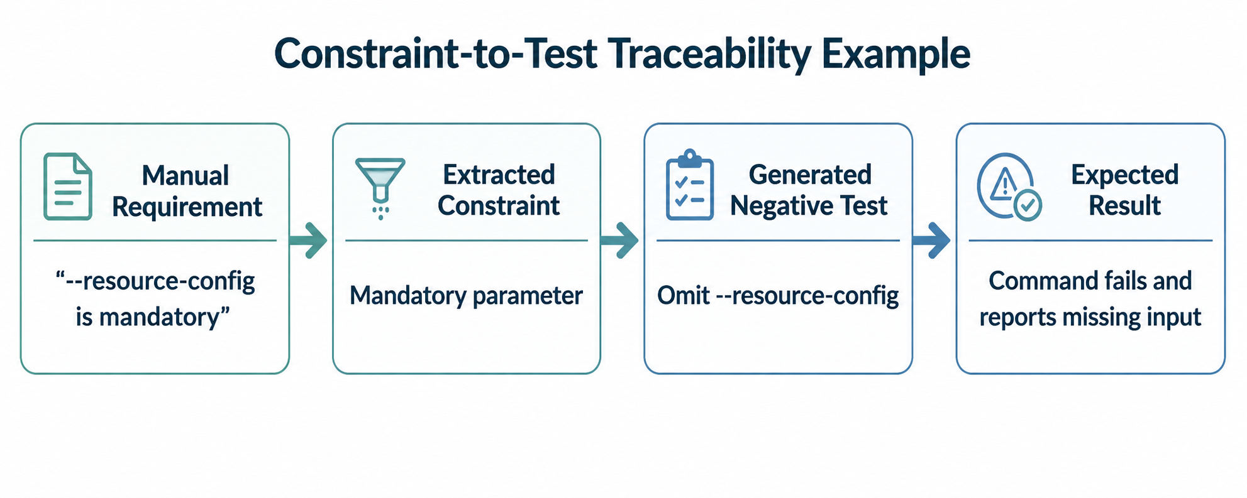
Using Gen-AI for Software Verification and
Validation
Zeynep Dila Kuyucu
Cemal Yılmaz
Haluk Şahin
Tutku Söker Kaya
ABSTRACT
PROJECT DETAILS II
This project presents an AI-assisted framework for generating and validating software test cases from technical documentation. The system takes a product manual or requirements document as input, retrieves relevant sections, extracts testable constraints, and uses a large language model to generate structured black-box test cases. To improve reliability, the generated cases are evaluated by a rule-based validation engine that checks structural completeness, content quality, semantic consistency, and traceability to extracted constraints. Invalid or incomplete cases are improved through an iterative repair loop that combines deterministic structural fixes with LLM-based semantic repair. The framework also includes a human-in-the-loop clarification step for ambiguous constraints and a Streamlit interface that makes the full pipeline transparent to the user. The resulting prototype demonstrates how generative AI can be combined with rule-based validation to produce more reliable, traceable, and auditable software test cases with reduced manual effort.
The main focus of the project is not only generating test cases, but also checking and improving their quality. Generated cases are validated by a rule-based engine exposed through a Model Context Protocol server. The validator checks structural completeness, naming format, step quality, expected result clarity, vague wording, duplicate steps, preconditions, test data, and traceability. In addition to these static rules, the system creates dynamic validation rules from the extracted constraints, allowing it to check whether each test case is grounded in the original document rather than being a generic LLM output.
If a test case is invalid or incomplete, the framework applies an iterative repair process. First, deterministic structural fixes correct issues such as missing fields, invalid names, malformed steps, or priority values outside the accepted range. If further improvement is needed, the LLM receives the validator feedback and repairs semantic or content-level issues while preserving traceability. The system also includes a human-in-the-loop clarification step for ambiguous constraints. A Streamlit interface makes the workflow transparent by displaying the retrieved document sections, extracted constraints, validation feedback, repair iterations, and final generated test cases.
OBJECTIVES
• Extract relevant and testable requirements from technical documentation.
• Generate structured black-box software test cases using a large language model.
• Validate generated test cases with rule-based structural, content, semantic, and traceability checks.
• Improve invalid or incomplete test cases through deterministic fixes, LLM-based repair, and optional human clarification.
CONCLUSIONS
This project produced a working prototype for generating, validating, and repairing software test cases from technical documentation. The results show that LLM-generated test cases become more reliable when generation is combined with rule-based validation, constraint coverage tracking, and iterative repair. The system reduces common LLM output problems such as missing fields, vague wording, weak expected results, and incorrect traceability. The human-in-the-loop clarification step also helps prevent unreliable test generation when extracted constraints are ambiguous. Overall, the project demonstrates that generative AI can support software verification and validation more safely when it is paired with systematic checking, transparent feedback, and auditable repair mechanisms.
PROJECT DETAILS
The project implements an AI-assisted pipeline that generates software test cases from technical documentation. A product manual or requirements document is processed, divided into relevant sections, and searched using semantic retrieval with sentence-transformer embeddings and FAISS. An LLM-based extractor then identifies testable constraints such as mandatory fields, allowed values, dependency rules, forbidden actions, and failure conditions. These constraints are used to generate structured black-box test cases with steps, expected results, test data, traceability, and covered constraint IDs.
REFERENCES
ISO/IEC/IEEE. (2022). ISO/IEC/IEEE 29119-1:2022 Software and systems engineering — Software testing — Part 1: Concepts and definitions.
Yuan, Z., Lou, Y., Liu, M., Ding, S., Wang, K., Chen, Y., & Peng, X. (2024). No more manual tests? Evaluating and improving ChatGPT for unit test generation.
Li, V., & Doiron, N. (2023). Prompting Code Interpreter to write better unit tests on QuixBugs functions.
Reimers, N., & Gurevych, I. (2019). Sentence-BERT: Sentence embeddings using Siamese BERT-networks.
Anthropic. (2024). Model Context Protocol (MCP).

