Slide 1

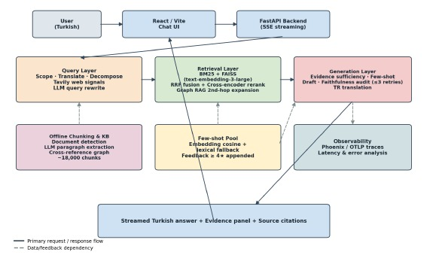
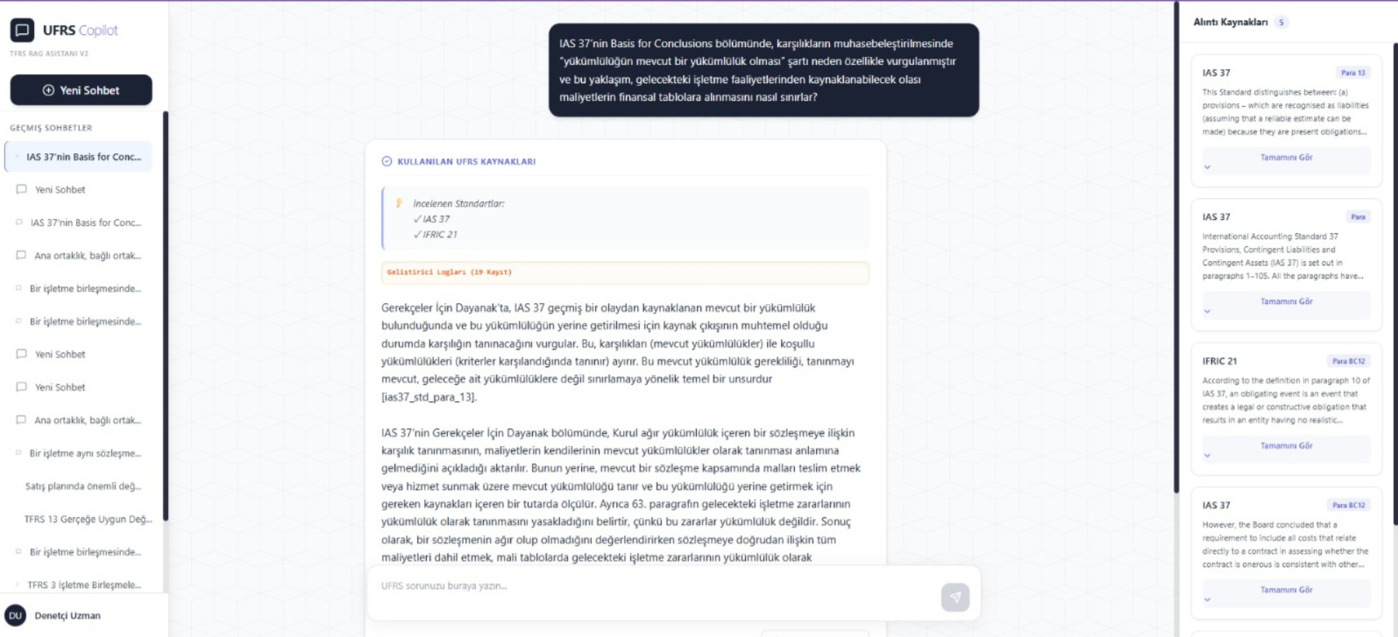

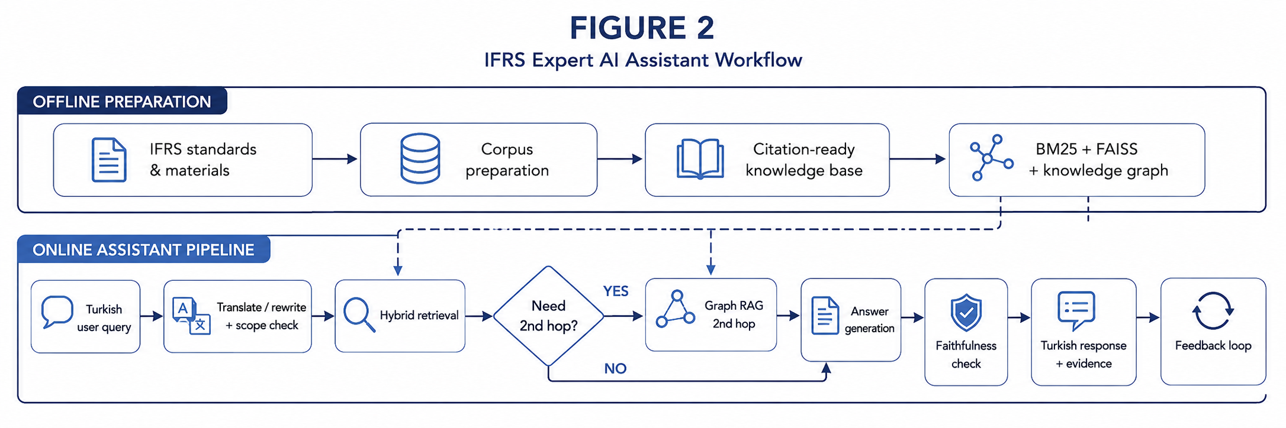
International Financial Reporting Standards Expert AI Assistant
Irmak Sözen
Buğra Aydın
İnanç Arın
Seçkin Altınel
Utku Doğanoğlu
ABSTRACT
PROJECT DETAILS II · SYSTEM LAYERS
Financial professionals need fast, defensible interpretations of IFRS, but manual lookup is slow and general-purpose language models cannot be trusted to provide paragraph-level support from authoritative sources.
This project delivers an IFRS-focused AI assistant that answers Turkish user questions while grounding every substantive statement in retrieved evidence. The system follows a modular Retrieval-Augmented Generation (RAG) architecture: an offline pipeline cleans and structures IFRS source texts into ≈18 000 paragraph-level chunks and a knowledge graph; the query layer translates and reformulates user questions into retrieval-ready English; a hybrid retriever combines BM25, FAISS dense search and cross-encoder reranking, with a Graph RAG second hop on harder questions; the generation layer checks evidence sufficiency, drafts an evidence-backed answer, verifies faithfulness with a self-correcting retry loop, and translates the approved answer back to Turkish.
Query layer: Scope screening, Turkish → English translation, decomposition for multi-part questions, web-signal enrichment for standard candidates, and conversation-aware rewriting.
Retrieval layer: Sparse BM25 + dense FAISS fused with weighted Reciprocal-Rank Fusion, then a cross-encoder reranker selects the top five. When the agent judges evidence weak, a Graph RAG second hop traverses cross-reference and sibling edges in the knowledge graph, activated on 54 % of evaluation questions.
Generation layer: Chunk-sufficiency check → embedding-similar few-shot selection → English draft grounded in retrieved chunks → dedicated faithfulness auditor → up to three regrounding retries → English → Turkish translation only after acceptance.
Backend integration: One coherent FastAPI workflow streams intermediate progress, retrieved evidence and the final answer over Server-Sent Events. Highly rated answers are appended to the few-shot pool via a feedback endpoint, providing a lightweight, curated improvement loop without full RLHF.
Reliability: The pipeline formalises a do-not-guess behaviour at the system level: if evidence is insufficient or the faithfulness gate cannot be passed after the configured budget, the assistant refrains from producing a finalised Turkish answer.
OBJECTIVES
CONCLUSIONS · RESULTS
Curate an IFRS corpus with paragraph-level citation support.Turkish→English query understanding, scope check and rewriting.Hybrid BM25 + FAISS retrieval, cross-encoder rerank, conditional Graph RAG second hop.
Faithfulness-gated generation that re-grounds or abstains rather than guessing.
Turkish chat UI with visible evidence and a ★-rating feedback loop.
An evidence-first IFRS assistant is both necessary and feasible for the financial-reporting domain. Structured corpus preparation, hybrid retrieval, reranking, conditional Graph RAG, faithfulness verification and visible citations together produce a workflow in which the generator rarely fabricates standards or paragraph references.
Agentic behaviour. Graph RAG second hop on 15 / 28 questions (54 %). The faithfulness gate accepted 20 first drafts, self-corrected 5 within the 3-attempt budget, and produced principled abstentions on 2 questions where evidence remained insufficient.
Limitation. Exact-paragraph Recall@K (45 %) is the clearest weakness: current chunks span whole sub-sections, so the dense retriever returns the broader chunk instead of the precise paragraph.
Future work. Build per-standard FAISS indices queried after the query layer identifies the relevant standard(s); cache and parallelise independent stages; extend to a larger multi-standard golden set; measure per-question cost and carbon footprint.
PROJECT DETAILS · METHODOLOGY
REFERENCES
1.IFRS Foundation. International Financial Reporting Standards (IFRS) and IAS Standards. IFRS Foundation, London, 2024.
2.Lewis, P. et al. Retrieval-Augmented Generation for Knowledge-Intensive NLP Tasks. NeurIPS, 2020.
3.Asai, A. et al. Self-RAG: Learning to Retrieve, Generate and Critique through Self-Reflection. ICLR, 2024.
4.Yao, S. et al. ReAct: Synergizing Reasoning and Acting in Language Models. ICLR, 2023.
5.Es, S. et al. RAGAS: Automated Evaluation of Retrieval-Augmented Generation. EACL, 2024.
6.LangChain. LangGraph: Stateful, Multi-actor LLM Applications. langchain-ai/langgraph, 2024.
Offline corpus: Document detection, text preprocessing, section parsing, cross-reference extraction, graph construction and validation produce ≈18 000 paragraph-level chunks plus a knowledge graph spanning standards, basis-for-conclusions material, implementa‐tion guidance and annotations.
Stack: Python · FastAPI · SSE streaming · FAISS · text-embedding-3-large · BM25 · cross-encoder ms-marco-MiniLM-L-6-v2 · LangGraph · Phoenix tracing · React + Vite.

