Slide 1

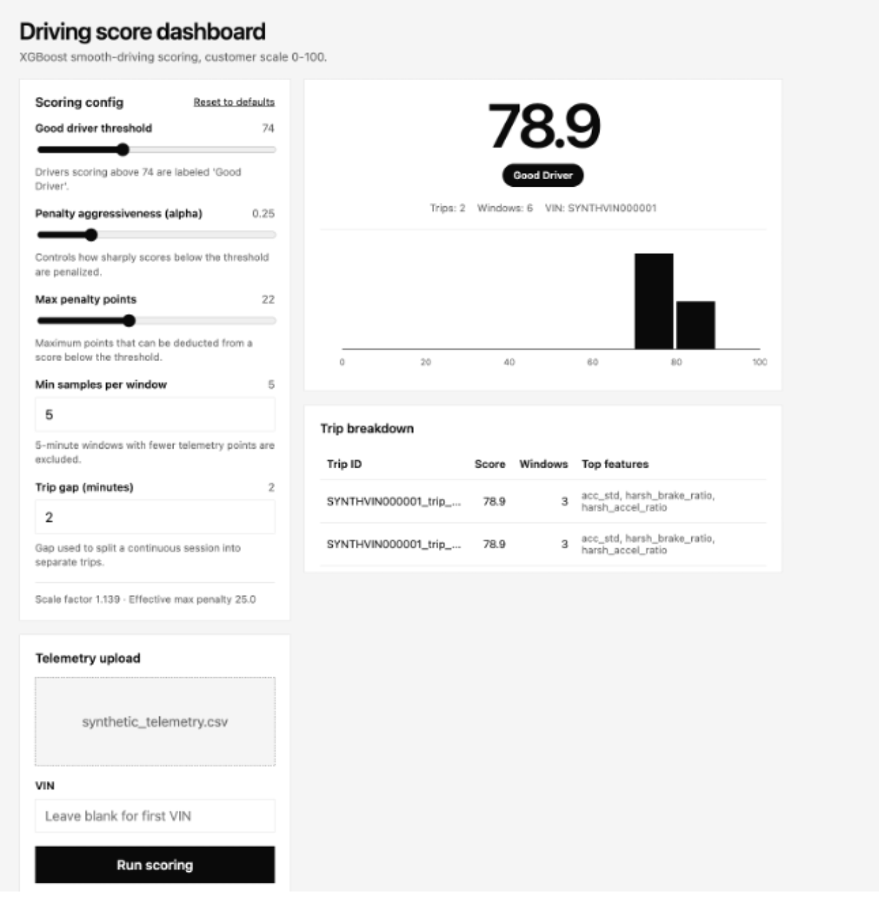
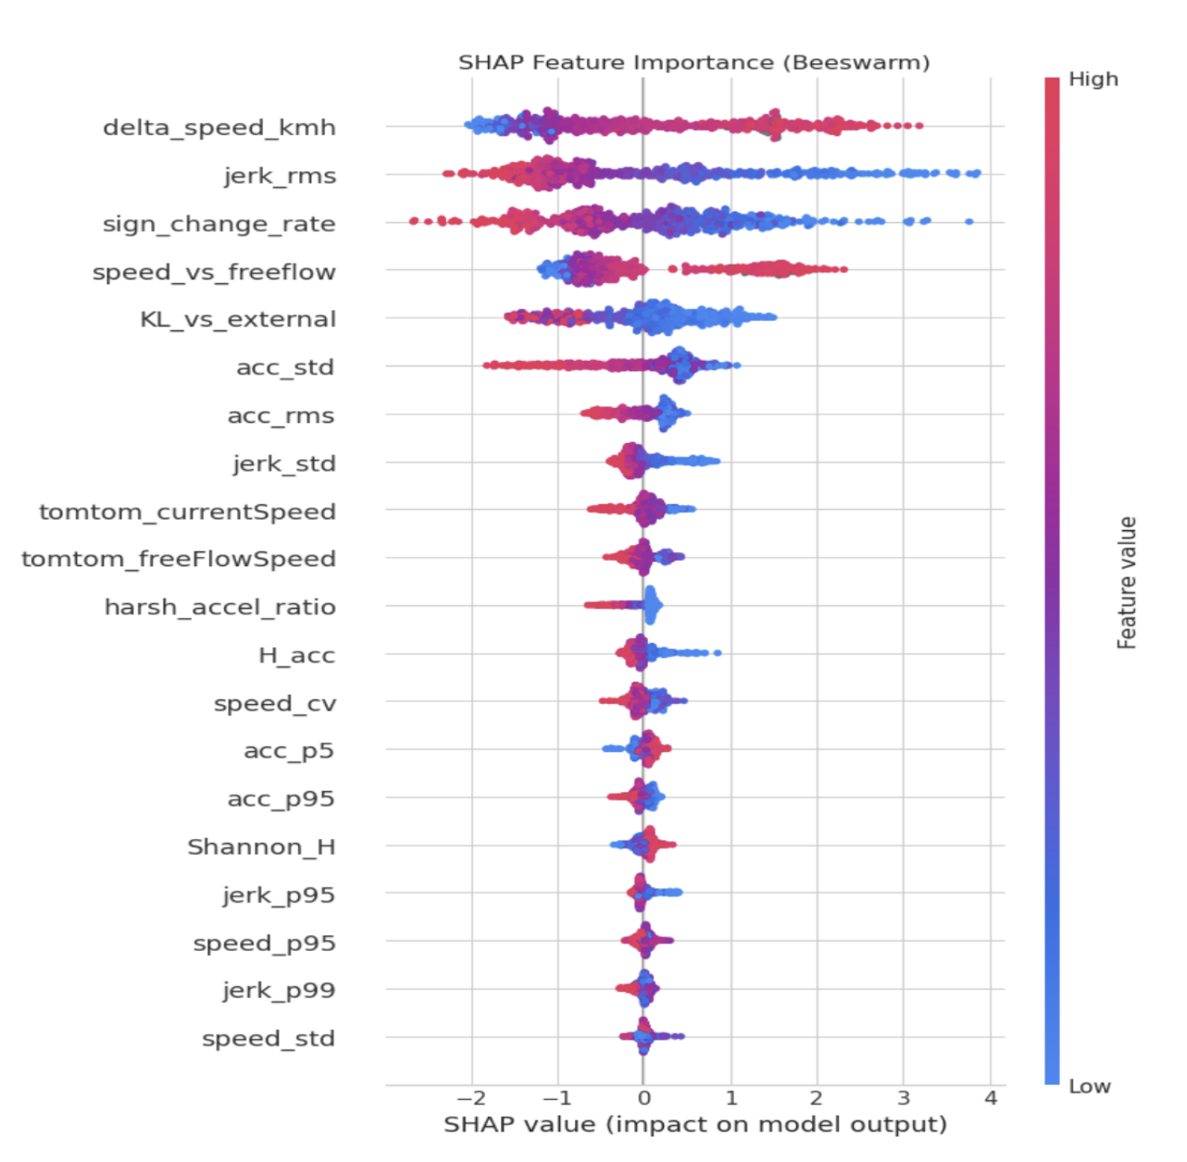
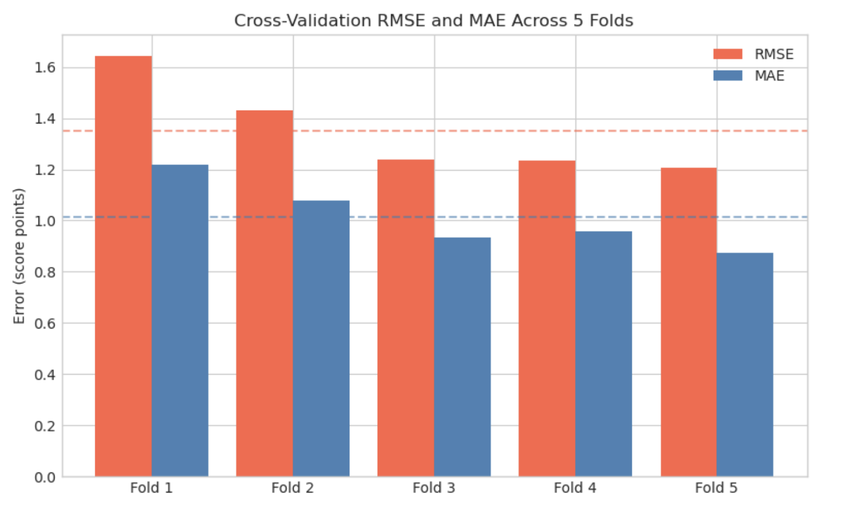
Automotive AI and Data Analytics
Melih Elibol | Ayşenur Gönül | Okan Kerem Çıtak
Prof. Mustafa Ünel
Vehicularis Limited
ABSTRACT
METHODOLOGY
ext_ref_divergence
Road traffic accidents cause approximately 1.2 million fatalities annually worldwide. Many accidents stem from unsafe driving behavior, yet existing telematics systems still assess drivers using basic rule-based methods that fail to capture the contextual and distributional aspects of driving risk.
This project introduces an intelligent and interpretable driver safety analysis system built on real-time Tesla telemetry data, developed in collaboration with Vehicularis Limited. The system processes over 800,000 timestamped records including vehicle speed, acceleration, braking behavior, jerk, and GPS coordinates, augmented with real-time traffic context from the TomTom Traffic Flow API.
The methodology operates in four integrated layers: (1) a behavioral variability modeling framework over 5-minute windows, (2) feature engineering across speed, acceleration, jerk, and traffic context domains, (3) XGBoost-based machine learning with physics-derived pseudo-labels, and (4) LLM-based personalized feedback via AWS Bedrock. SHAP analysis identifies jerk metrics, acceleration stability, and speed deviation relative to traffic flow as primary risk predictors. The system is deployed on AWS with a REST API and web dashboard.
Layer 1 — Information-Theoretic Framework
Telemetry is segmented into 5-minute windows. A statistical framework quantifies behavioral diversity and deviation from reference distributions within each window, capturing both intra-session anomalies and deviation from prevailing traffic conditions.
Layer 2 — Feature Engineering (20+ Features)
Group A (Speed): distribution shape, mean, std, percentiles, divergence metrics. Group B (Acceleration): RMS, std, sign-change rate, harsh events. Group C (Jerk): RMS, std, p95/p99 — computed with 30-second overlap. Group D (Traffic Context): TomTom currentSpeed, freeFlowSpeed, congestion ratio, speed vs. free-flow.
Layer 3 — XGBoost Scoring Pipeline
An XGBoost model (n_estimators=300, max_depth=5) is trained on a physics-based pseudo-label (smooth_score) applying context-aware penalties for jerk, harsh braking, acceleration hunting, and speed violations. GroupKFold cross-validation (5 folds by trip_id) prevents data leakage. Scores are calibrated to a customer-facing scale where 65 (internal) maps to 80.
Layer 4 — LLM Feedback (AWS Bedrock)
For windows with customer score below 70, a structured JSON prompt (timestamp, score, delta_speed, jerk_rms, top-3 SHAP features) is sent to Claude 3.5 Haiku via Bedrock. The LLM generates plain-language, personalized driving recommendations in 3–4 sentences, triggered for at most 3 windows per vehicle per session.
PROJECT DETAILS
CONCLUSIONS
Raw Tesla telemetry (800K+ records) is stored in Amazon S3. Preprocessing includes speed conversion (mph to km/h), GPS parsing, trip segmentation via DynamoDB journey records (10-min gap heuristic), and exclusion of rows missing VehicleSpeed or timestamps. TomTom Traffic Flow API provides real-time current and free-flow speeds at each window’s median GPS coordinates. For ~20–30% of windows where TomTom data is unavailable, an OSM Overpass API fallback retrieves posted speed limits.
This project delivered a production-ready, cloud-native driver safety pipeline demonstrating that statistical behavioral modeling can be effectively combined with gradient-boosted machine learning and SHAP explainability to produce unified, interpretable driver safety scores.
Key Findings:
(1) Jerk-based features (jerk_rms, jerk_std) are the strongest predictors of driving quality. (2) Traffic context features (delta_speed_kmh, congestion_ratio) are genuinely informative when context-aware pseudo-labels are used. (3) The log-floor penalty and 65→80 barem calibration produce a psychologically motivating score scale. (4) Feedback-driven behavior change programs reduce accident rates by 15–25% in UBI contexts (Ebert et al., 2026).
Future Work:
Expand to multi-VIN datasets across diverse geographies; acquire expert-annotated ground-truth labels; integrate lateral dynamics (steering angles, regenerative braking); conduct longitudinal field trial; transition to serverless AWS Lambda architecture.
OBJECTIVES
REFERENCES
RESULTS & DISCUSSION
All 7 project objectives were realized on schedule. Cross-validation RMSE ranged from 0.9–1.6 score points across 5 folds, demonstrating generalization across trips. SHAP analysis shows jerk_rms as the single most impactful feature, followed by delta_speed_kmh (deviation from TomTom flow) and sign_change_rate. Context features (congestion_ratio, speed_vs_freeflow) appear in the top half of the importance ranking, confirming the value of traffic-aware pseudo-labels. ROC AUC for SpeedLimitWarning validation was 0.504, attributable to extreme label sparsity. The LLM feedback layer generated coherent, actionable plain-language recommendations for all high-risk windows tested.
[1] Shannon, C.E. (1948). A mathematical theory of communication. Bell System Technical Journal, 27(3), 379–423.
[2] Kullback, S. & Leibler, R.A. (1951). On information and sufficiency. Annals of Mathematical Statistics, 22(1), 79–86.
[3] Guillen, M. et al. (2024). Pricing weekly motor insurance drivers with behavioral and contextual telematics data. Heliyon, 10, e36501.
[4] Ebert, J.P. et al. (2026). A national randomized field experiment testing the impact of simulated usage-based insurance programs on driver safety. Accident Analysis & Prevention, 225, 108331.
[5] WHO (2023). Road traffic injuries. https://www.who.int
[6] TomTom International (2024). Traffic API – Flow Segment Data. https://developer.tomtom.com

